Slide 1
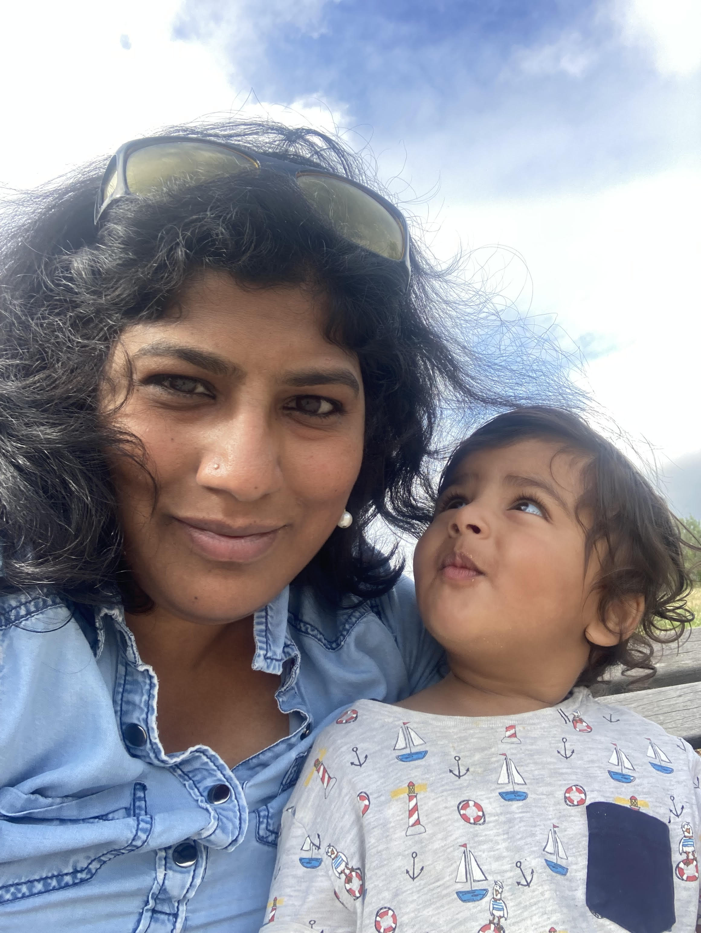


Neurodiversity and Inclusion in Product Design - Embrace the edge cases and think beyond average users
Speaker Image Placeholder
Vaishnavi Venkata Subramaniam Software Engineer, Electronic Arts

Slide 2
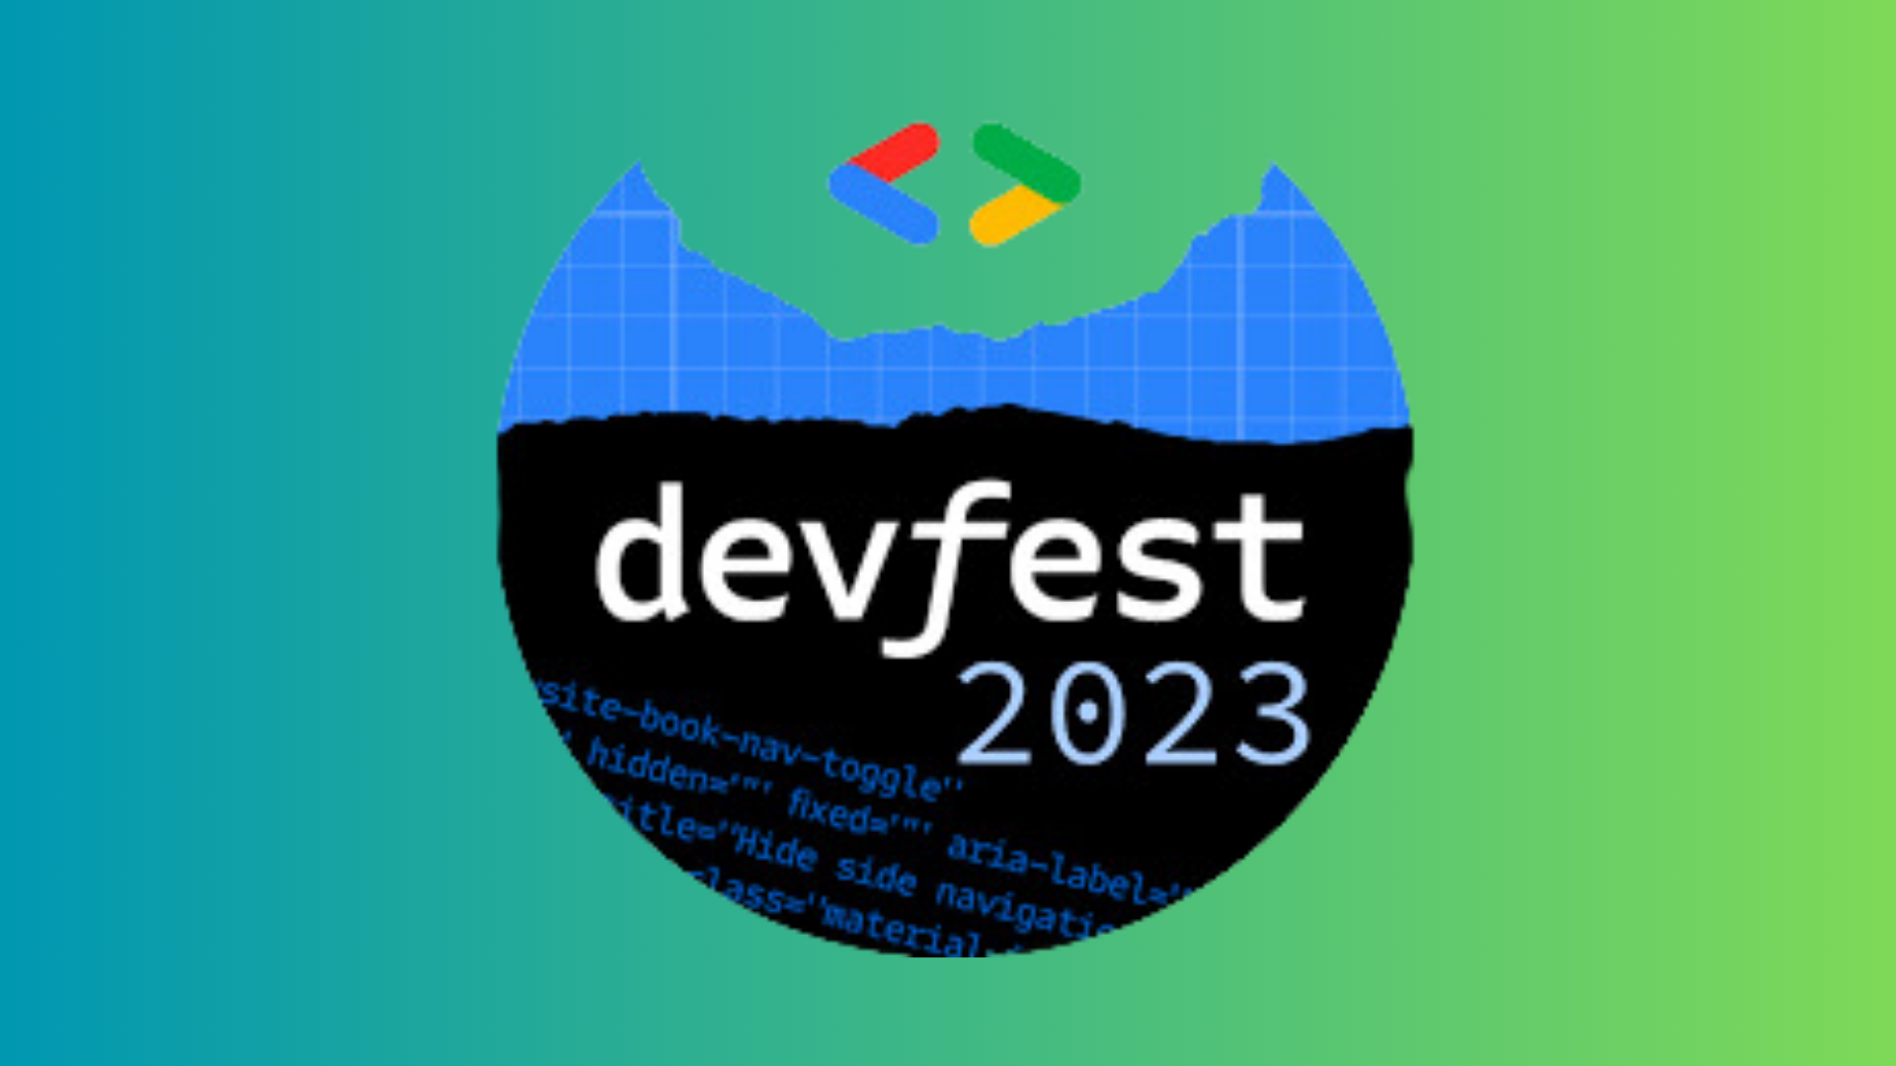
Glossophobia

Slide 3


Slide 4
Agenda
What is Neurodiversity?
Accessibility vs ND
Guidelines for Design
Concluding Remarks

Slide 5
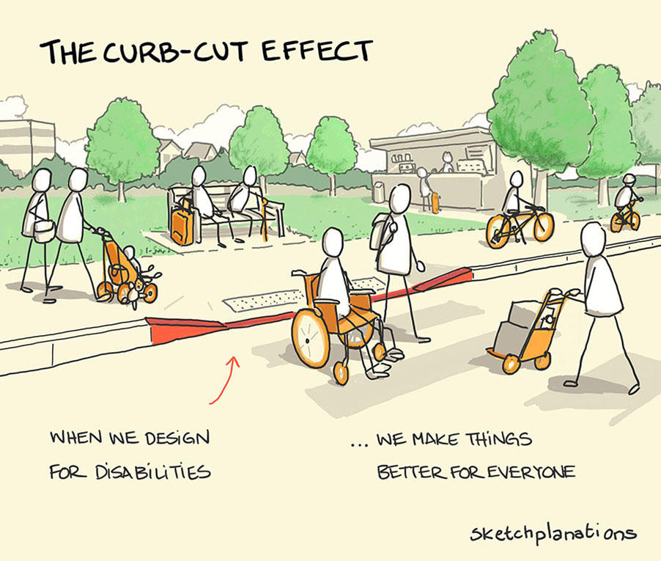
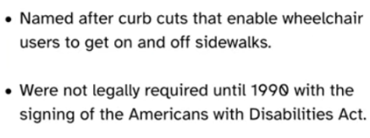
Credit: Sketchplanations
(https://sketchplanations.com/the-curb-cut-effect)

Slide 6
Solve for one, extend to many
Everyone has abilities and limits.
Creating products for people with permanent disabilities creates results that benefit everyone.

Slide 7
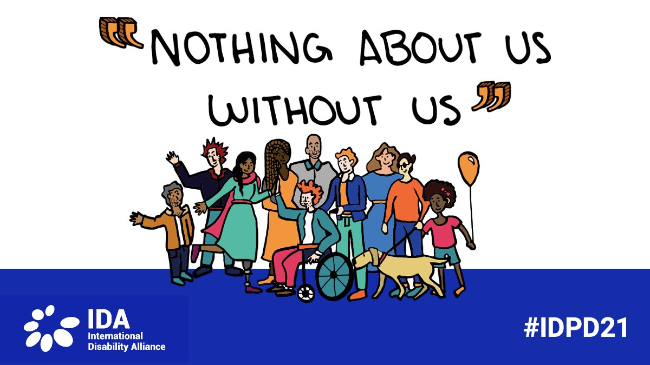

Slide 8
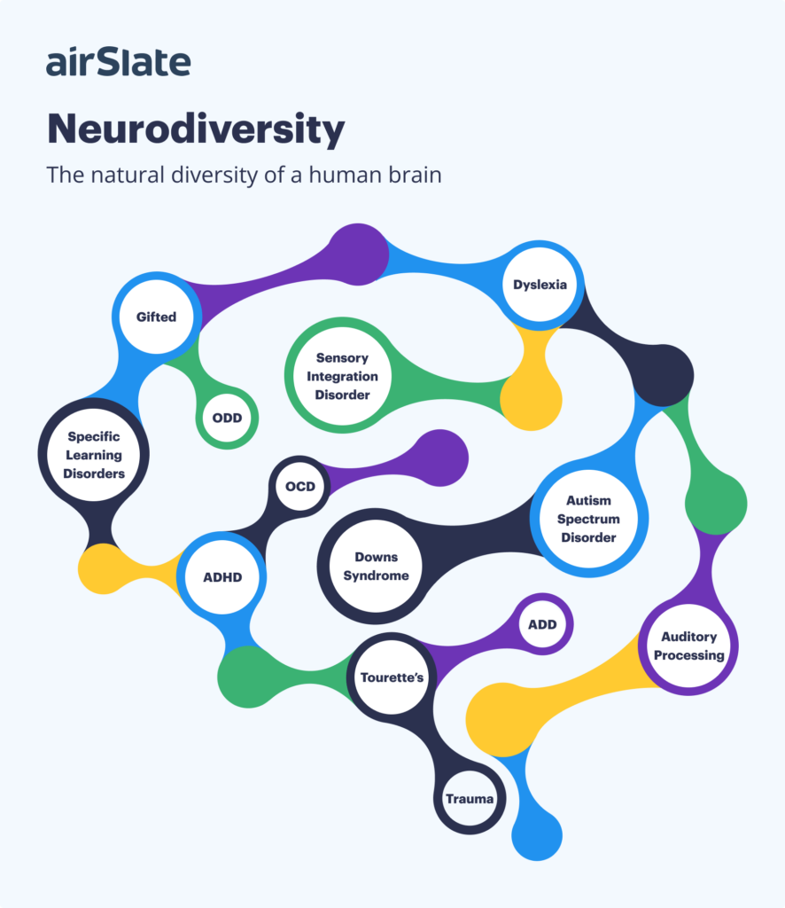
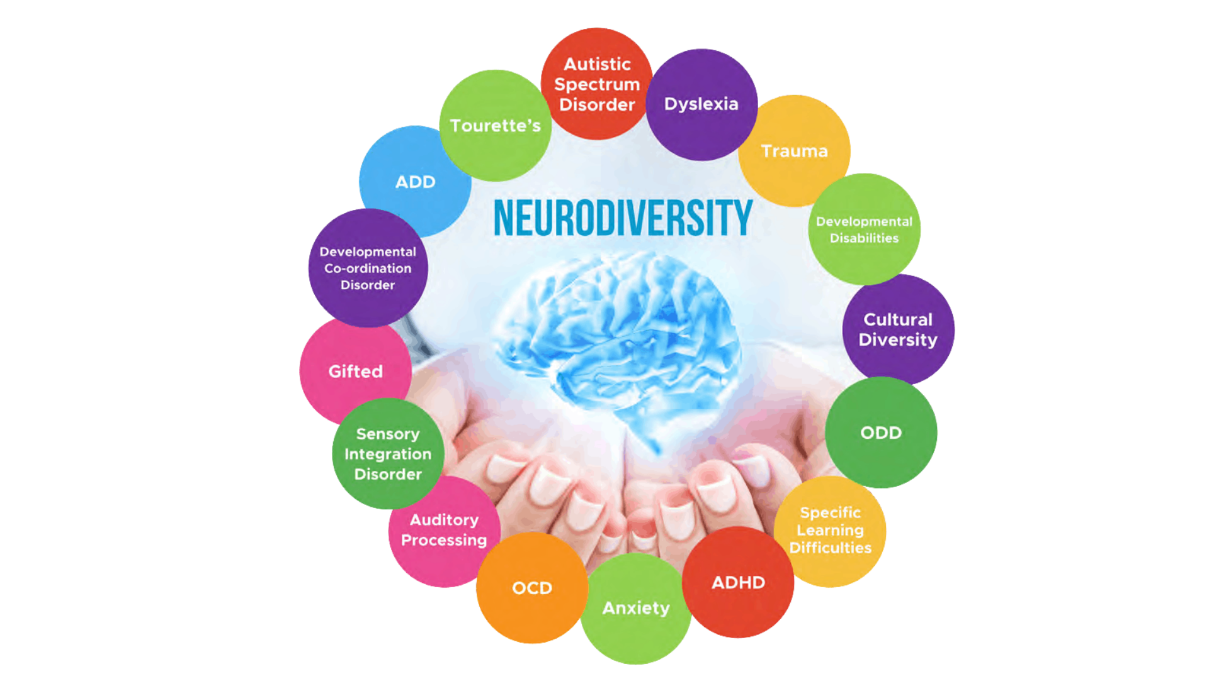
Not an edge case!
Neurodiversity is often
invisible. What’s more—it often stays invisible.

Slide 9
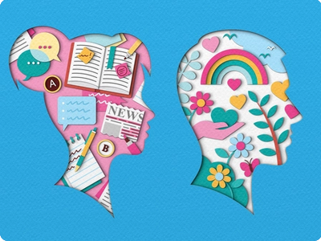
Definition
Measurable, biological differences in the
way the brain is wired to process
Social interactions
Intellectual understanding
Emotions and behaviors
A social model of disability
Credits: https://dribbble.com/zaraillustrates

Slide 10
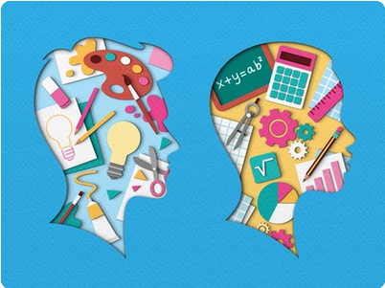
Undeniable
Neurodivergent brains are biologically different.
One cannot be "trained out of" the way their brain works
Credits: https://dribbble.com/zaraillustrates

Slide 11
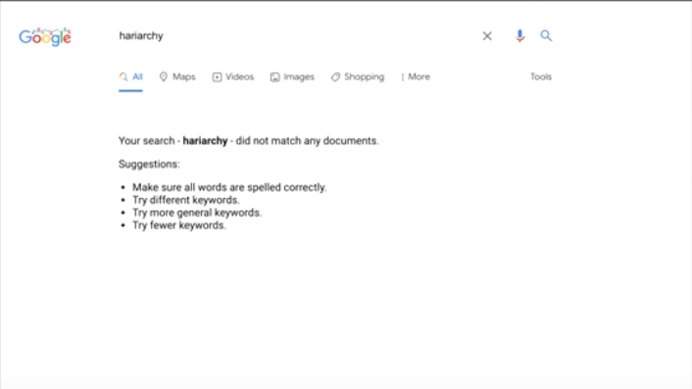
Dyslexia

Slide 12
Abundance and not redundance
Kinder and Forgiving products
Gaming and Neurodiversity
Design Guidelines

Slide 13
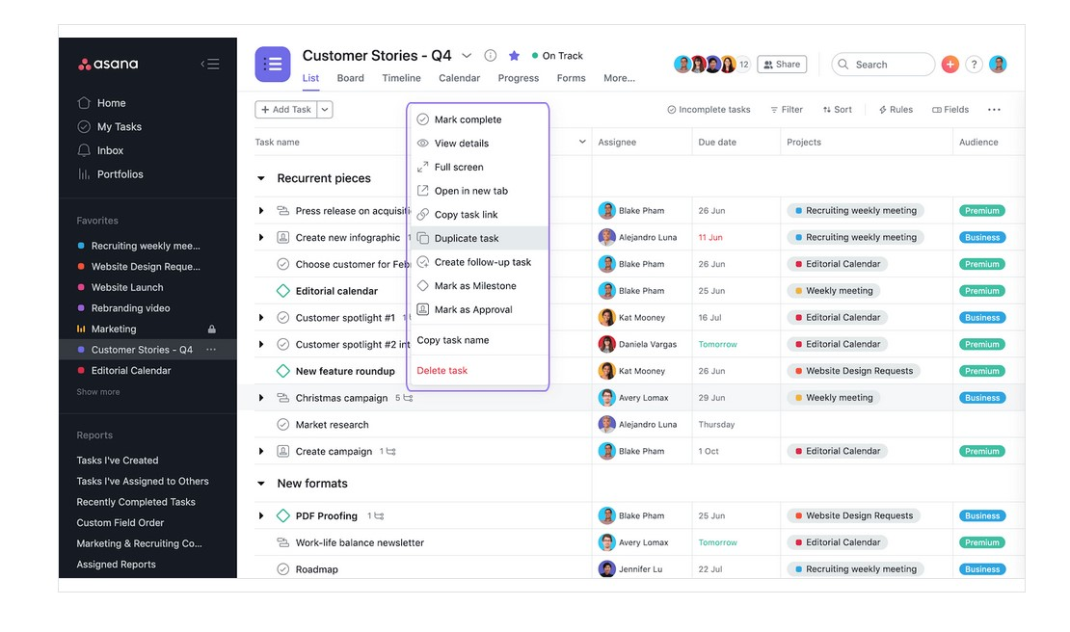
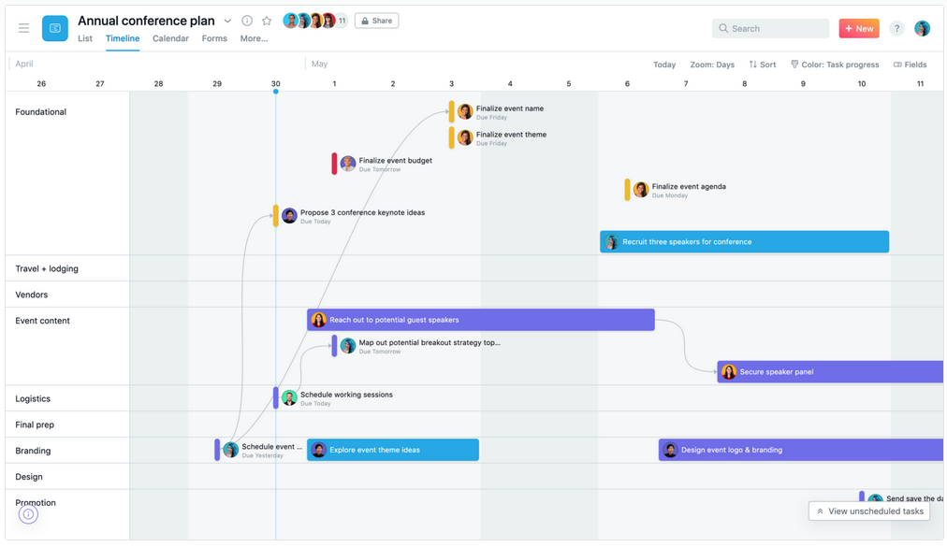
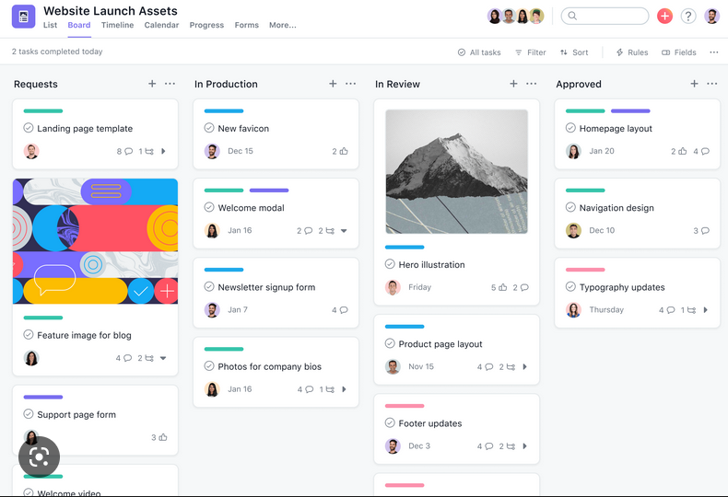
Abundance and not redundance
Source : Asana multiple views. Title Credits : Trace M
Notes:
Different learning styles

Slide 14
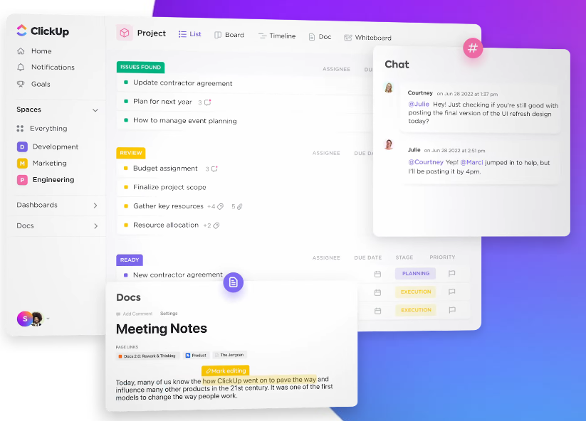
Abundance and not redundance
Source : ClickUp. Title Credits : Trace M
Notes:
Different learning styles

Slide 15
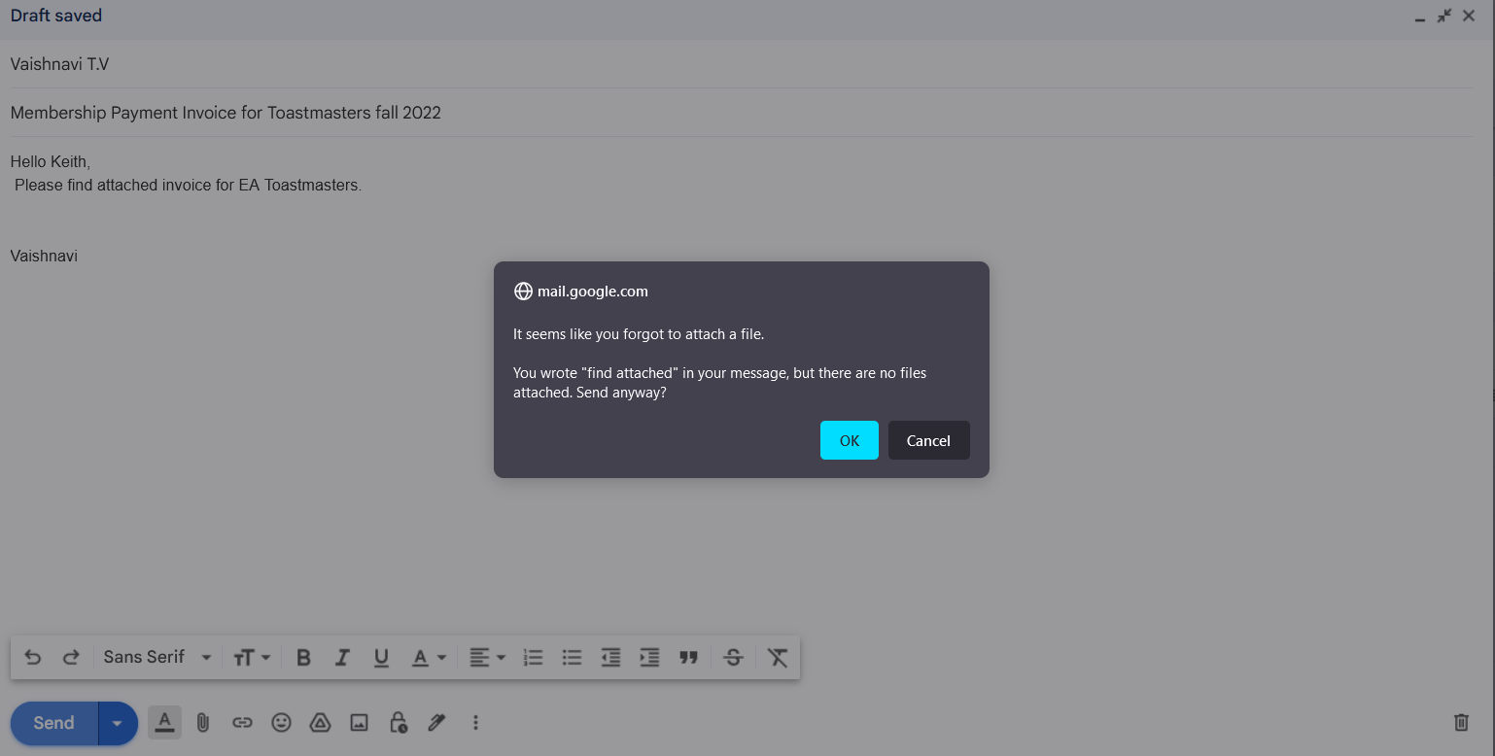
Be Kind and Forgiving

Slide 16
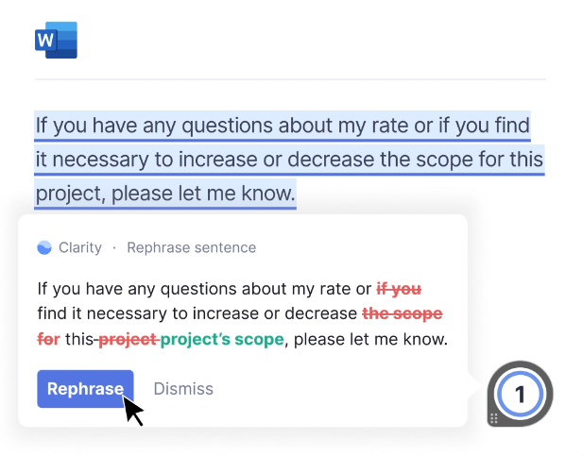
Be Kind and Forgiving
Grammarly - Disneyland of Spelling checker and beyond

Slide 17
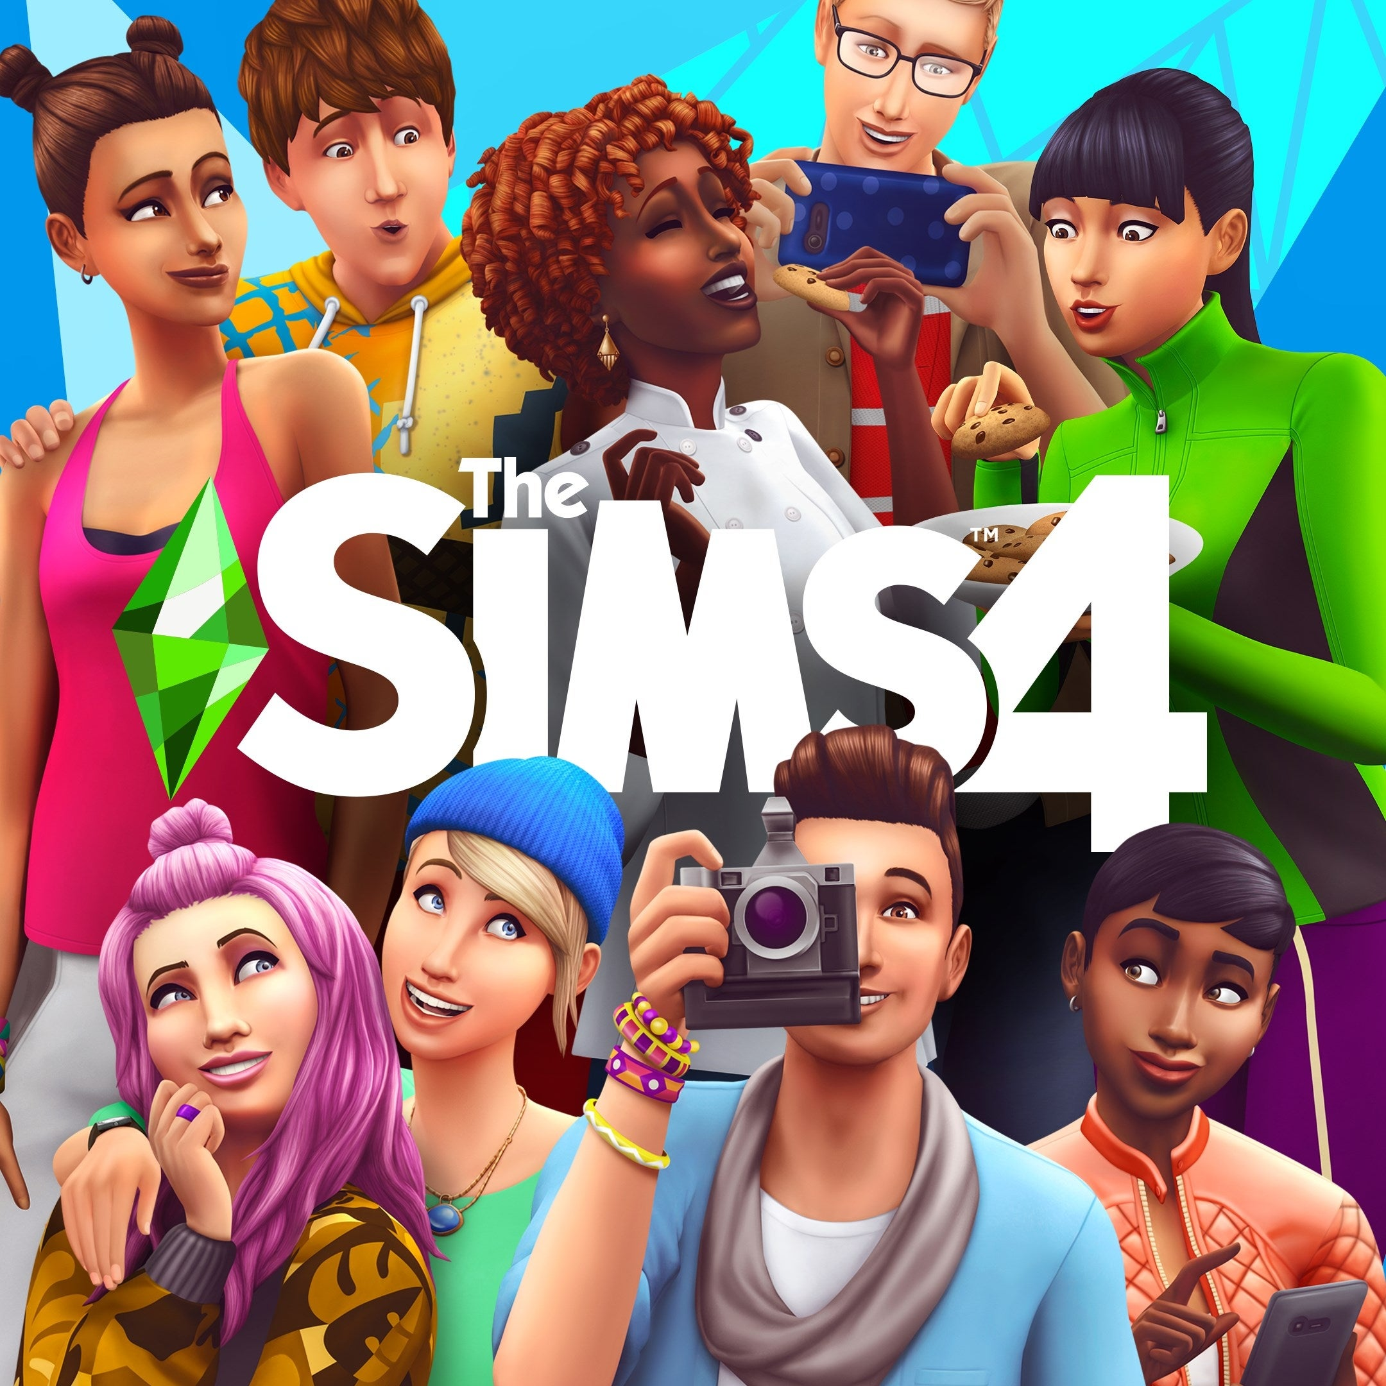
The Sims is a game of comfort for so many neurodiverse people
Notes:
Not punishing
structured social interactions and the ability to create different situations act almost like a laboratory for real life

Slide 18
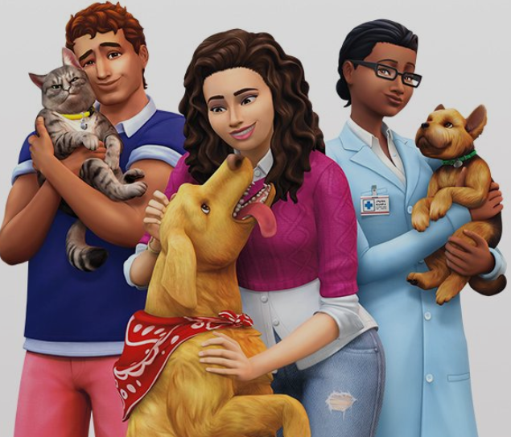
Play in different ways depending on my mood. allows to build and create
Play out different situations in a safe environment.
Explore relationship dynamics that don't come naturally to us
“A new trait – now a Sim could be an ‘overachiever.’ When applied, he would get bored and restless when his life became dormant. When he took on challenging tasks, he was so happy and fulfilled.

Slide 19
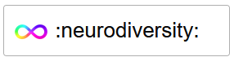
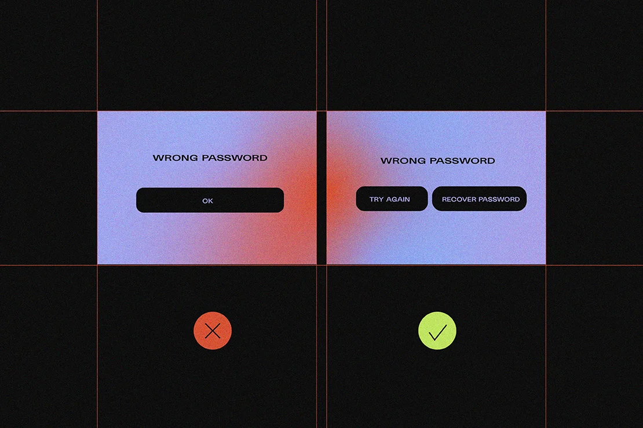
Guidelines

Slide 20
Guidelines
Interpretable messages
Avoid use of characters that look alike
E.g. 1lI, B8, QO0CD, and try to break up long strings in phone numbers e.g. (000) 000–0000
Stick to active voice: Sentences in the passive voice are longer and harder to comprehend. Users with ADHD will get bored, dyslexics will have even more trouble reading, and so will readers on the spectrum.
Avoid metaphors: Trouble understanding metaphors, such as idioms and other abstract figures of speech.
E.g. Instead of calling it a day, it’s more inclusive to say that something is done.

Slide 21
Guidelines
Interpretable messages
Avoid use of characters that look alike
E.g. 1lI, B8, QO0CD, and try to break up long strings in phone numbers e.g. (000) 000–0000
Stick to active voice
Avoid metaphors: Trouble understanding metaphors, such as idioms and other abstract figures of speech.
E.g. Instead of calling it a day, it’s more inclusive to say that something is done.

Slide 22
Guidelines
Format your writing: Divide large chunks of text into smaller paragraphs. It is challenging for people struggling with limited attention spans.
Use descriptive buttons: No vague microcopy, such as Click here.
Describe the purpose of the button.
Example: Upload images, Register, Download the e-book.
This simple change makes navigation smoother and reduces anxiety.
Be careful with animations: Too much stimulation can induce anxiety in people on the autism spectrum, which may even lead to physical pain, withdrawal, or meltdown. Use of animated elements should be limited to instances when it serves a purpose. Also remember not to make them too invasive.

Slide 23

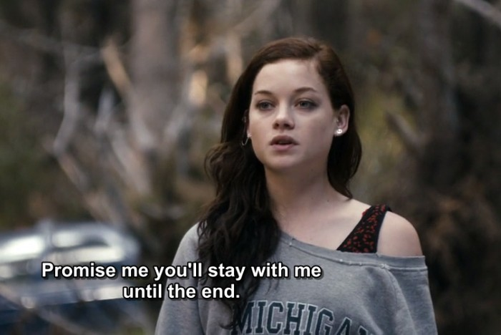
Guidelines
Avoid autoplay: Unexpected movement is surprising and scary, not to mention the sound!
Add subtitles and captions
Bring in the perspective of ND users and perform
user testing and focus groups with them.
Notes:
: Sometimes neurodiverse users can
find it hard to understand sound or visuals. It works the other way round, too –
It pays off to provide a picture to illustrate the text.
Not only is it too stimulating but also distracting – while users on the spectrum will be overwhelmed, the ADHD group will find it hard to focus. Even a small distraction on a website often makes him lose track completely.

Slide 24
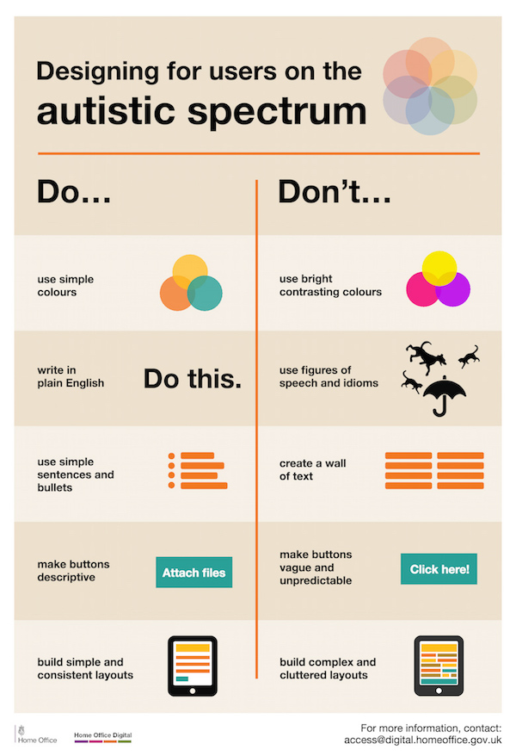

Slide 25
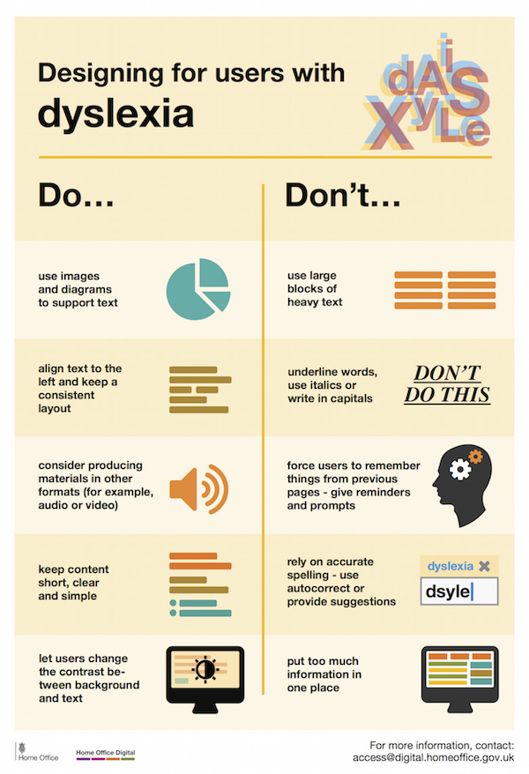

Slide 26
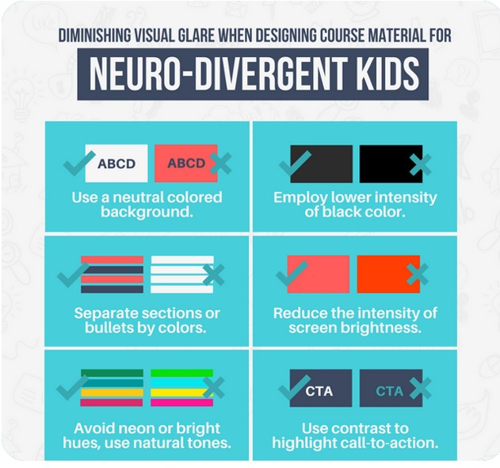
Credit : DesignMantic

Slide 27
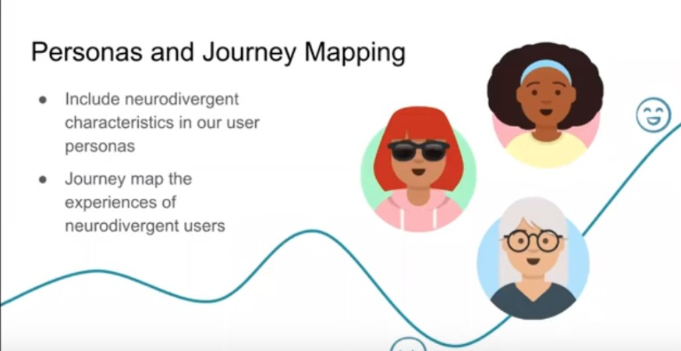

Slide 28
Design affecting our five senses
Keeping light, acoustics,
Colour, sequencing,
Compartmentalization,
Transition,
Sensory,
Escape, and
Restoration in mind

Slide 29
Great Minds Think Unalike And Learn Differently Representation Matters!

Slide 30
A design with inclusivity and neurodiversity in mind is not just ‘nice to have’ – it’s imperative

Slide 31
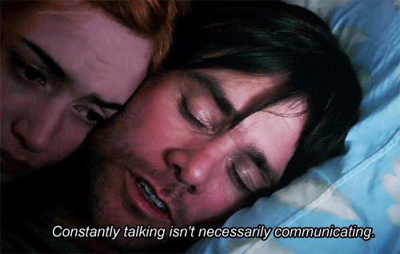

Slide 32
